Slide 1

Ecommerce Data Analysis
-By:
Sumidha Kumari Prasad

Slide 2
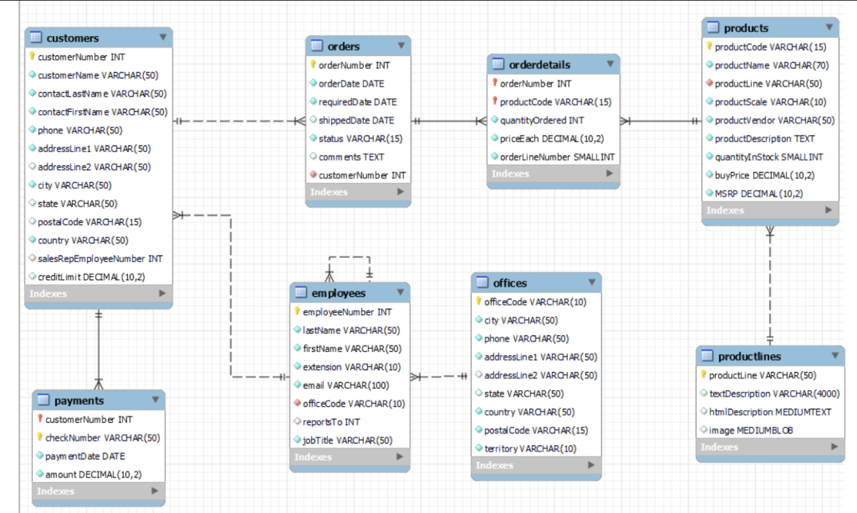
About
Framed 13 KPIs and solution for the KPIs for better understanding of Ecommerce Data Analysis.
There are 7 tables:
Customers, Orders, Payments, Orderdetails, Employees, Office, Products, ProductLines
ER Diagram:

Slide 3
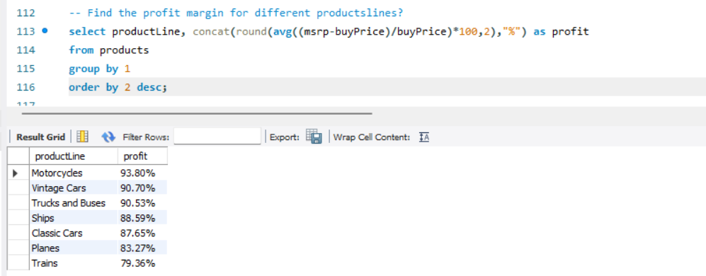
Question1

Slide 4
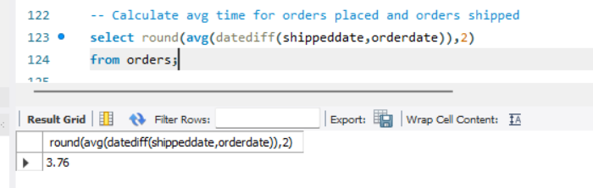
Question 2

Slide 5
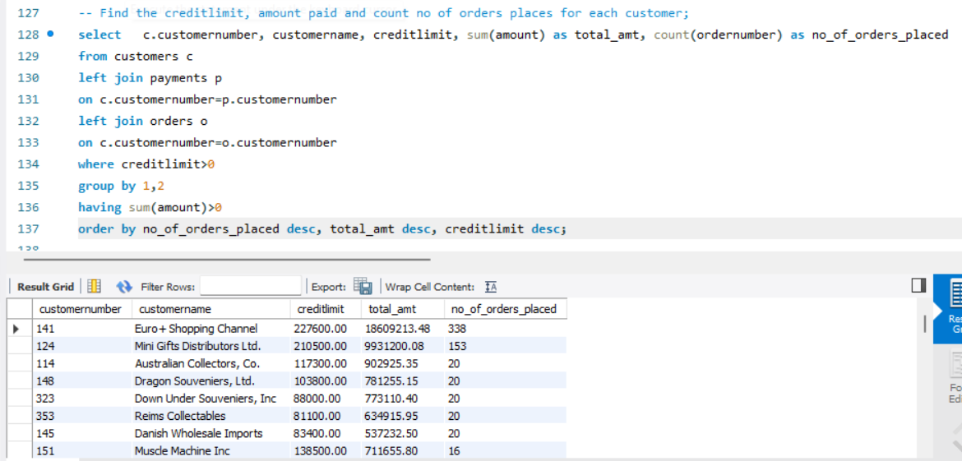
Question 3

Slide 6
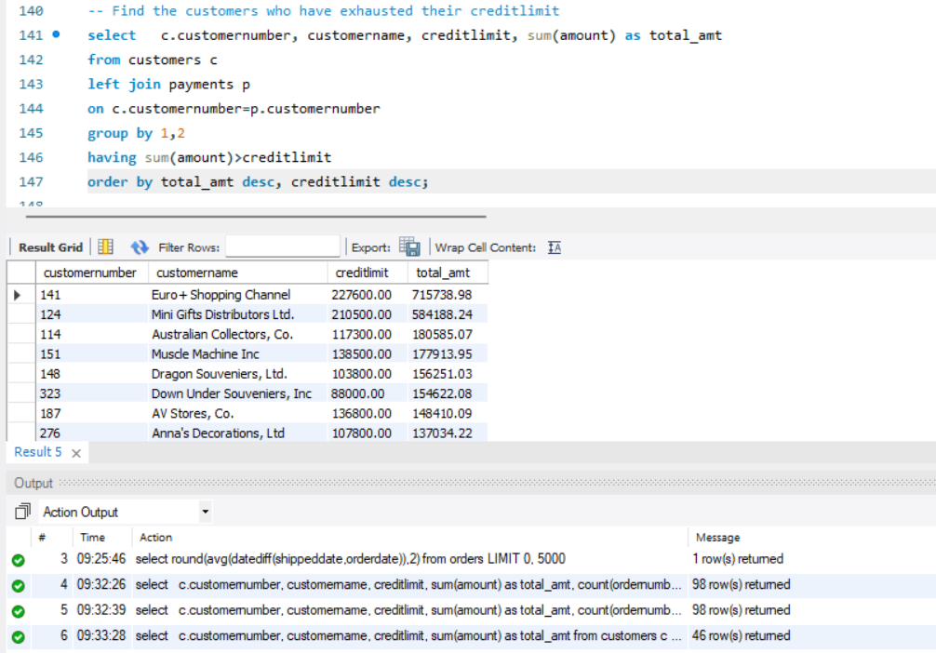
Question 4

Slide 7
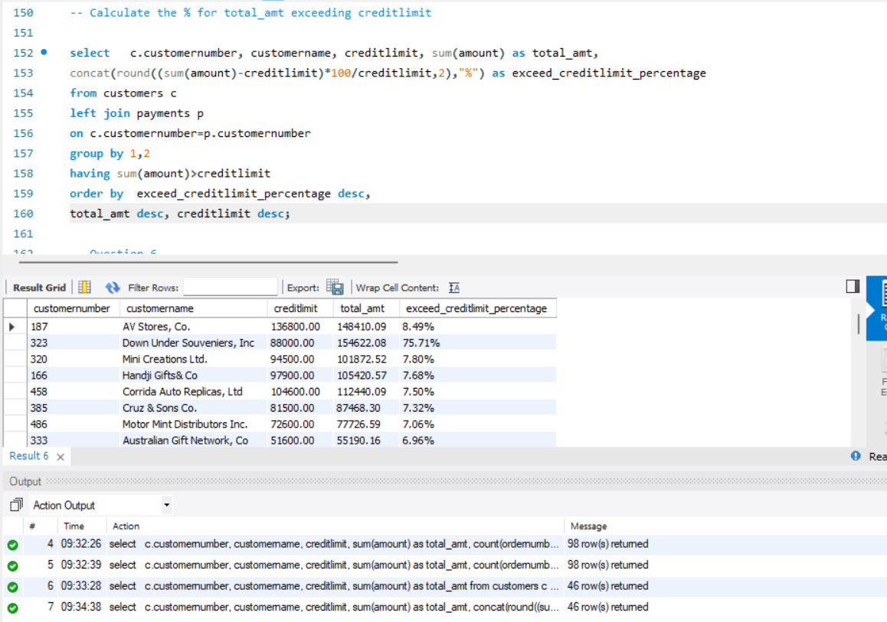
Question 5

Slide 8
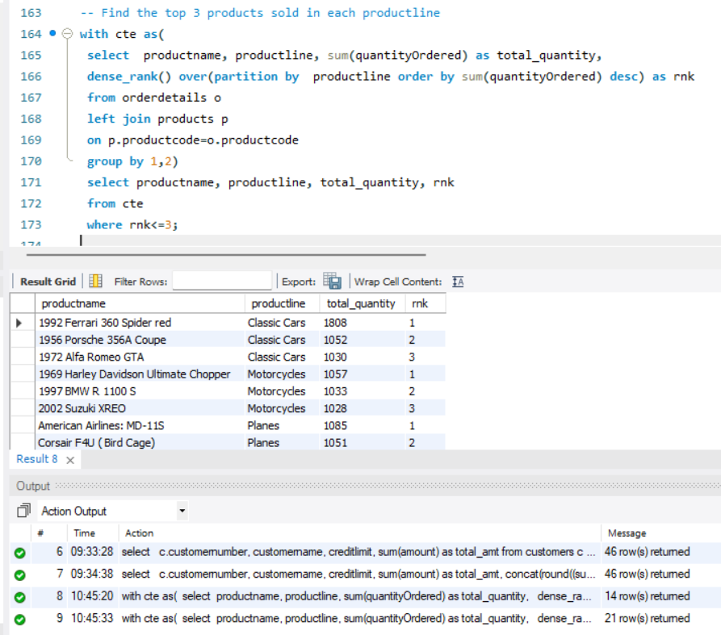
Question 6

Slide 9
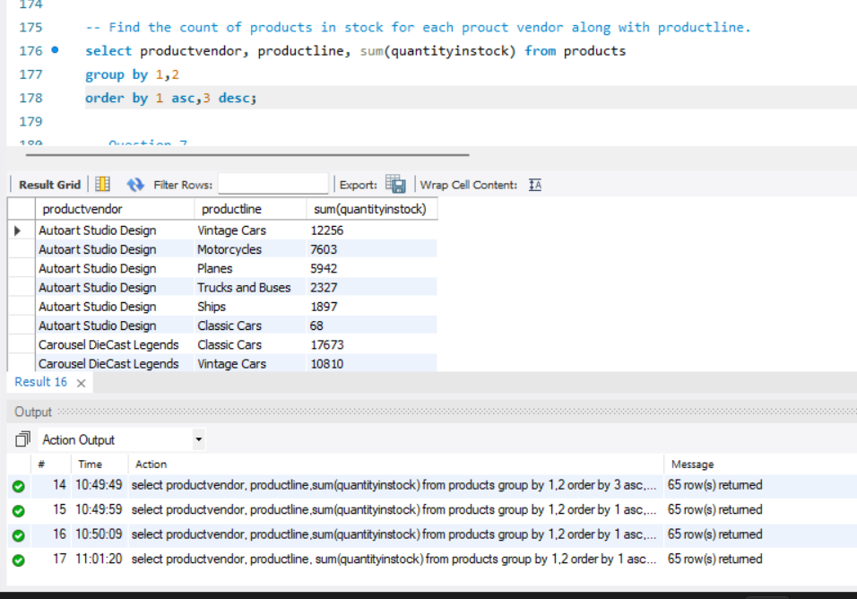
Question 7

Slide 10
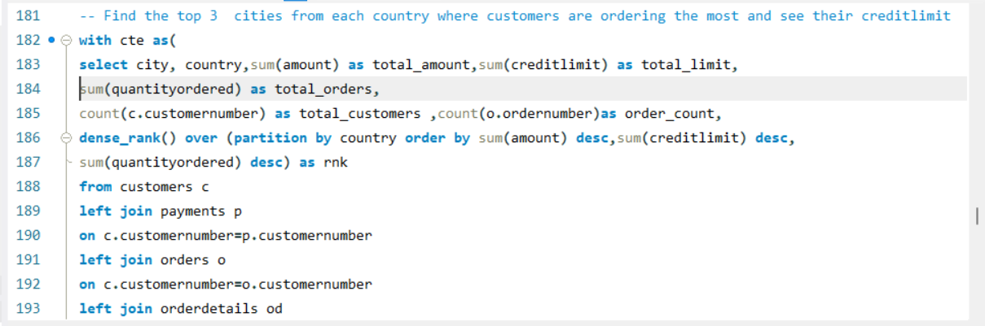
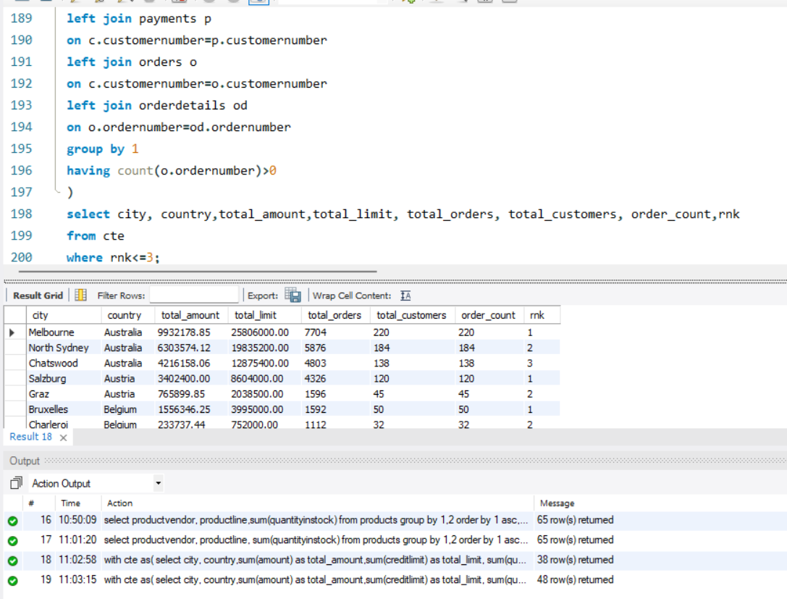
Question 8

Slide 11
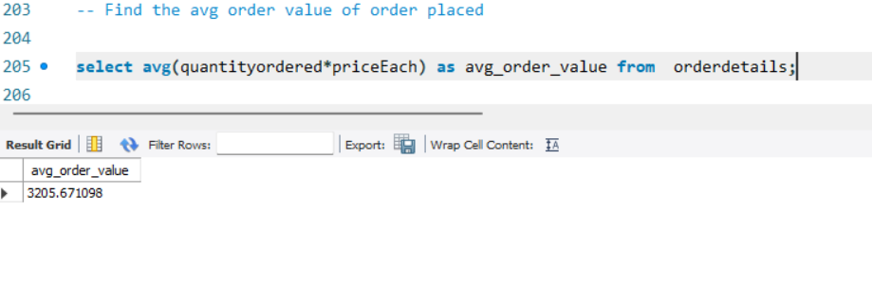
Question 9

Slide 12
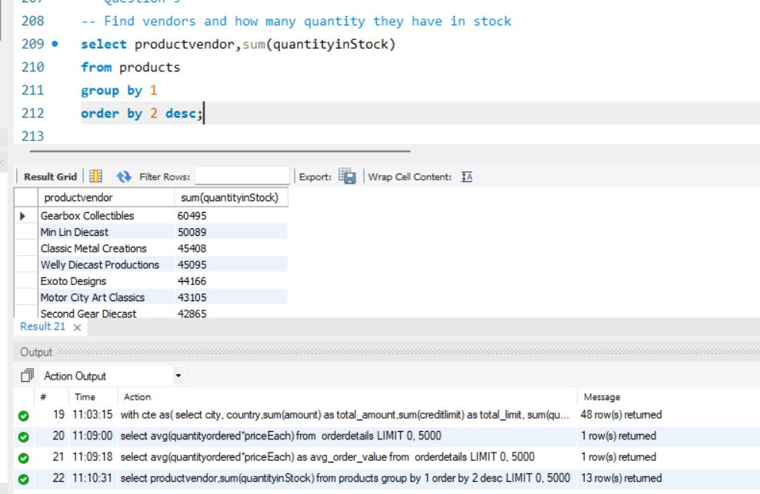
Question 10

Slide 13
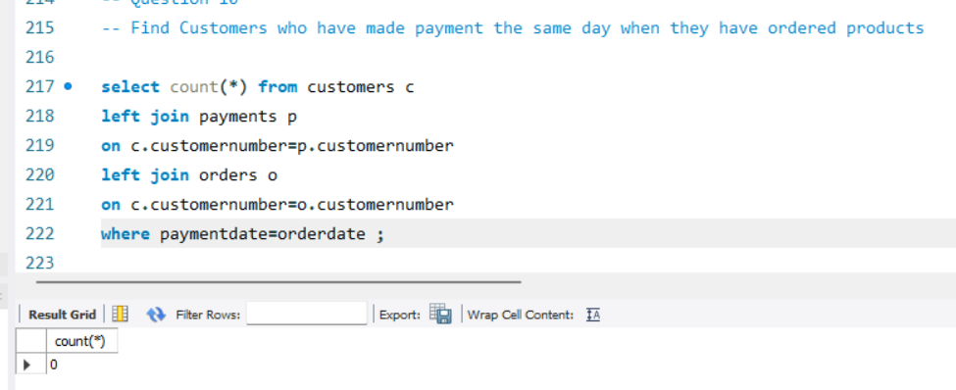
Question 11

Slide 14
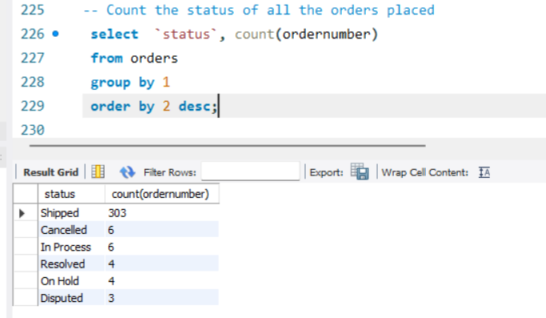
Question 12

Slide 15
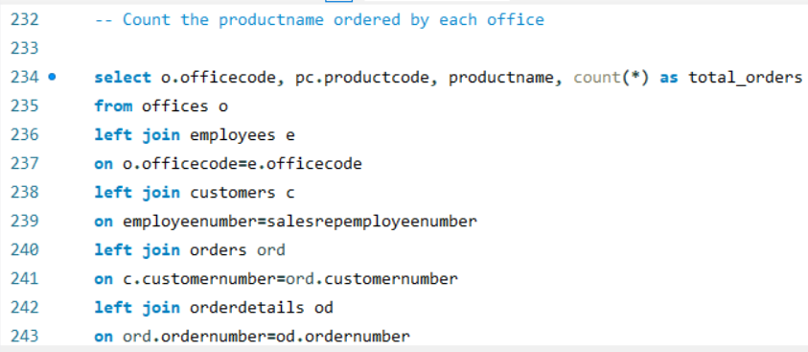
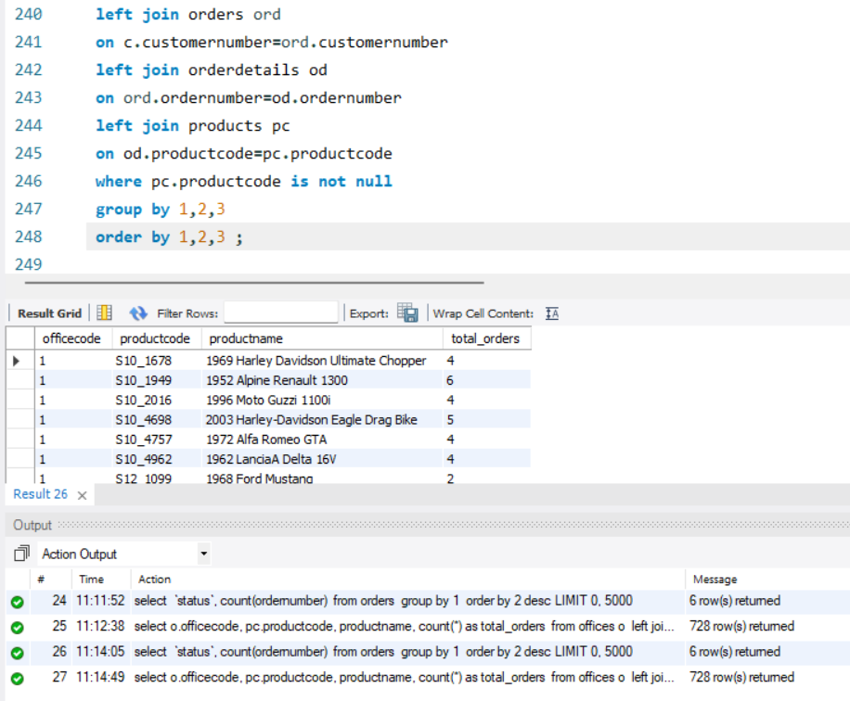
Question 13

Slide 16
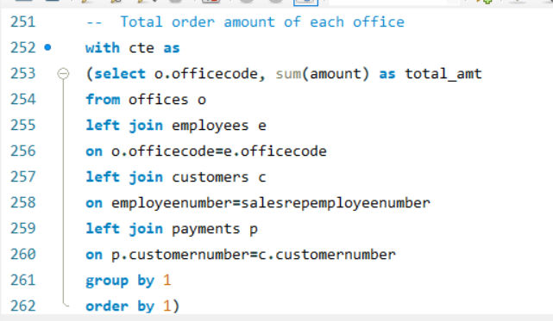
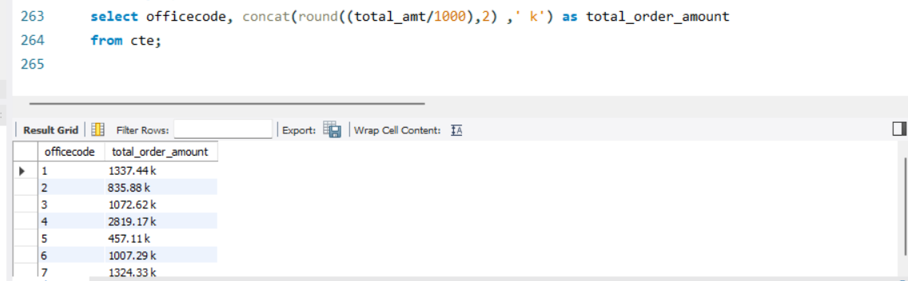
Question 14

Slide 17
THANK
YOU

